Slide 1
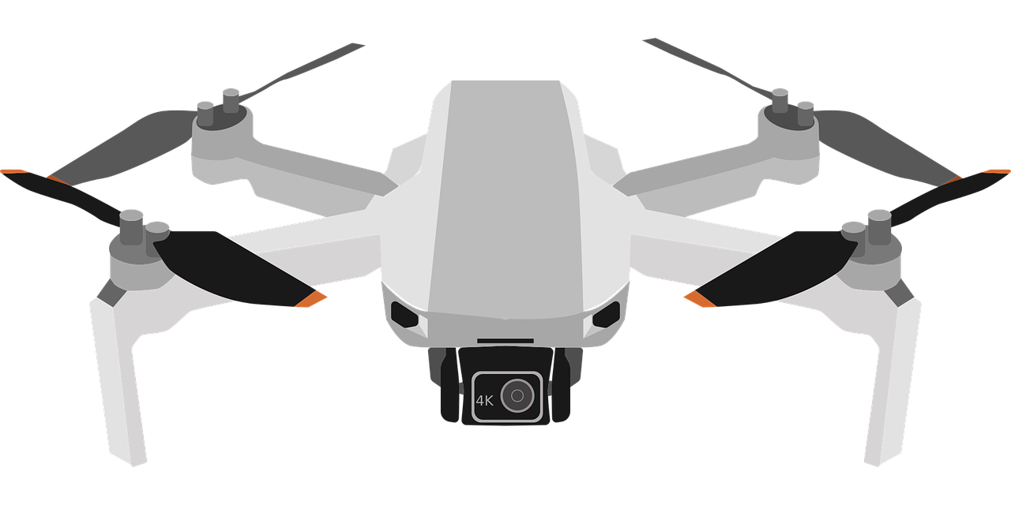
Applications And Roles of IOT in DRONE system

Slide 2
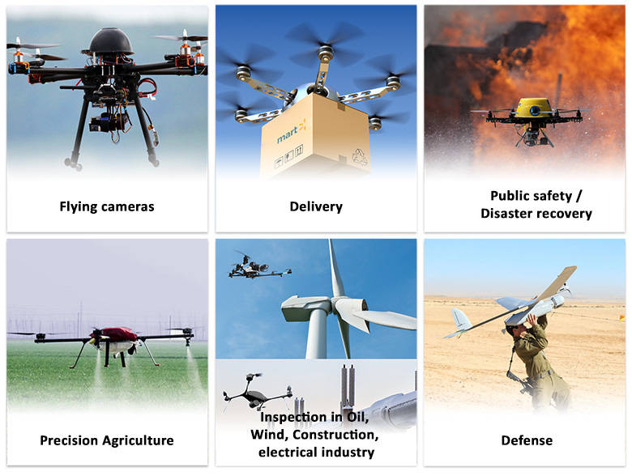
What is a Drone?
A drone is an unmanned aircraft. Drones are more formally known as unmanned aerial vehicles (UAVs) or unmanned aircraft systems.
Essentially, a drone is a flying robot that can be remotely controlled or fly autonomously using software-controlled flight plans in its embedded systems, that work in conjunction with onboard sensors and a global positioning system (GPS).
UAVs were most often associated with the military. They were initially used for anti-aircraft target practice, intelligence gathering and, more controversially, as weapons platforms. Drones are now also used in a range of civilian roles, including the following:
search and rescue, surveillance, traffic monitoring, weather monitoring, firefighting, personal use, drone-based photography, videography, agriculture, delivery services

Slide 3
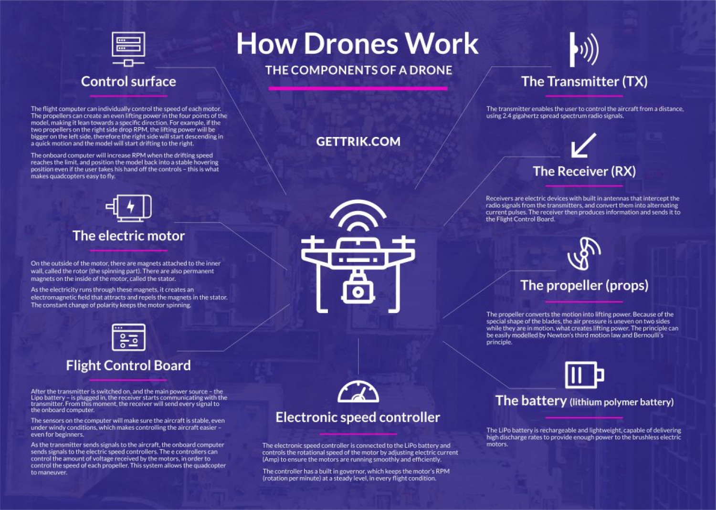
How do drones work?
Drones have two basic functions:
flight mode
navigation
To fly, drones must have a power source, such as battery or fuel. They also have rotors, propellers and a frame. The frame of a drone is typically made of a lightweight, composite material to reduce weight and increase manoeuvrability.
Drones require a controller, which lets the operator use remote controls to launch, navigate and land the aircraft. Controllers communicate with the drone using radio waves, such as Wi-Fi.

Slide 4
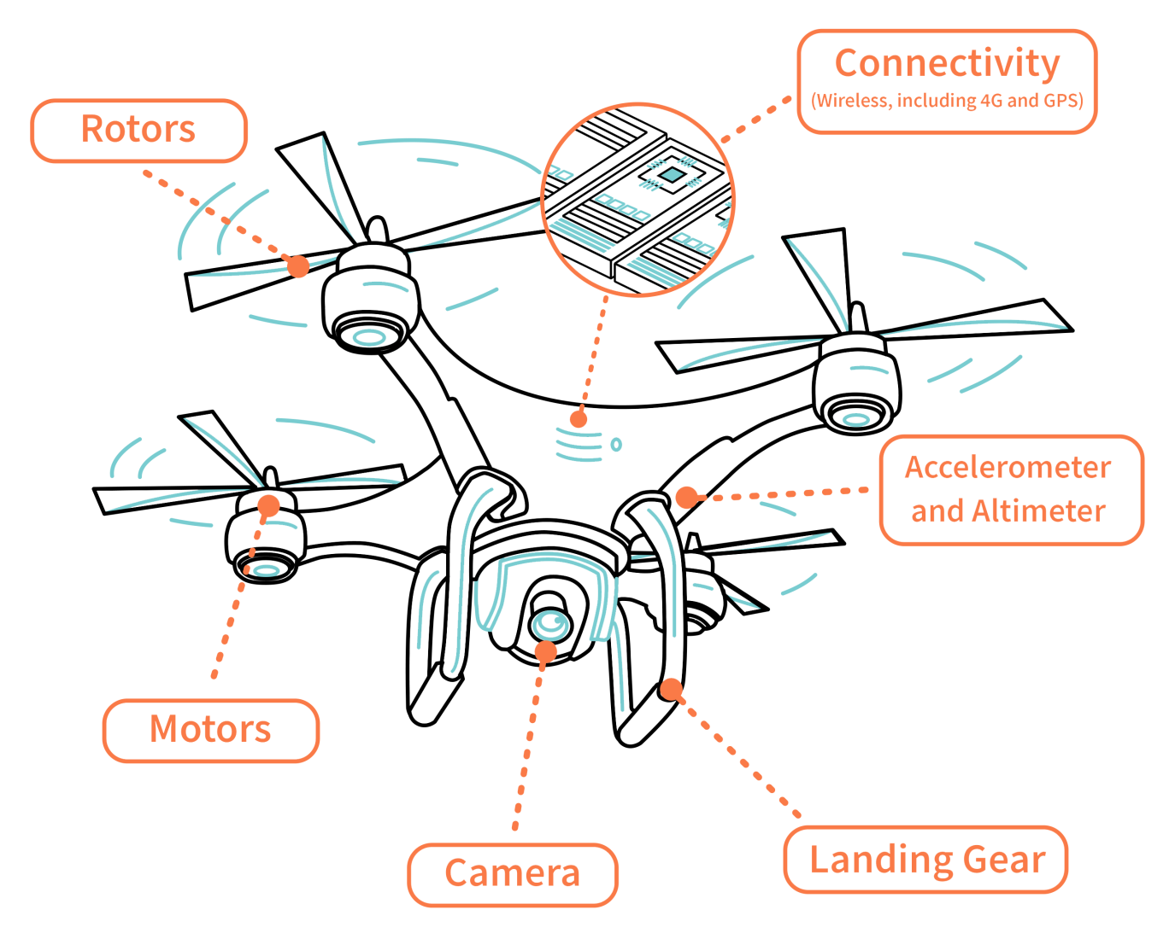
What are common drone features and components?
Drones have a large number of components, including:
electronic speed controllers, which control a motor's speed and direction flight controller
GPS module
Battery
Antenna
Receiver
Cameras
sensors, including ultrasonic sensors and collision avoidance sensors
accelerometer, which measures speed and
altimeter, which measures altitude.

Slide 5
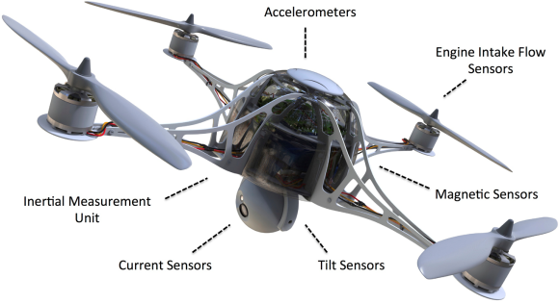
How Many Sensors are there in a Drone?
Accelerometers
Inertial Measurement Units
Tilt Sensors
Current Sensors
Magnetic Sensors
Engine Intake Flow Sensors

Slide 6
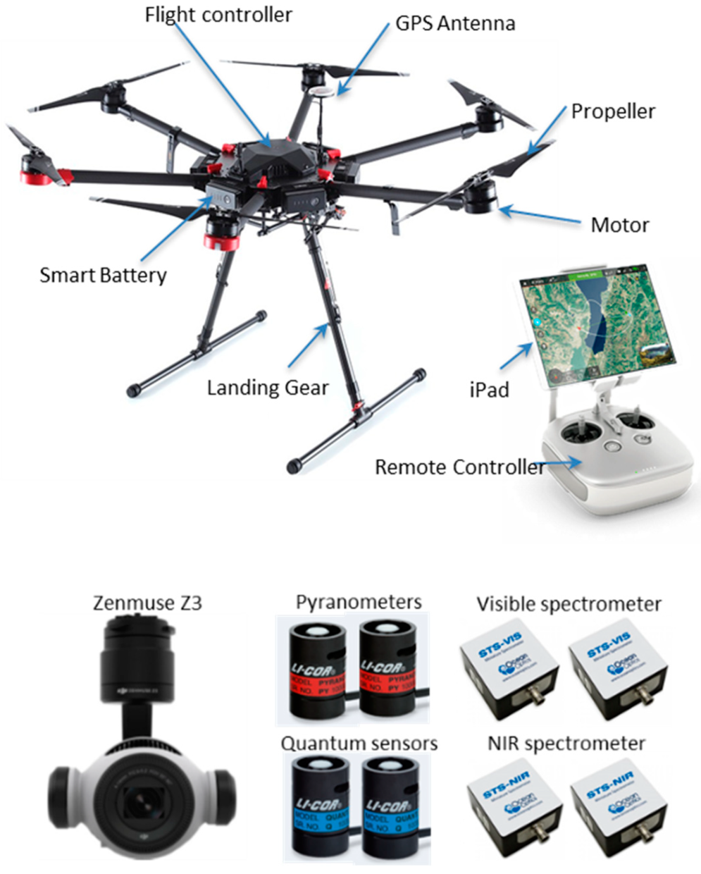
USES OF SENSORS :
Accelerometers
An accelerometer sensor is a tool that measures the acceleration of any body or object in its instantaneous rest frame.
Tilt Sensors
A tilt sensor, or tilt switch, is a device used for measuring the tilt of an object in multiple axes with reference to an absolute level plane
Current Sensors
A current sensor is a device that detects and converts current to an easily measurable output voltage
Engine Intake Flow Sensors
The most common type of mass air flow (MAF) sensor is located inside the intake air duct between the air filter and the throttle body

Slide 7
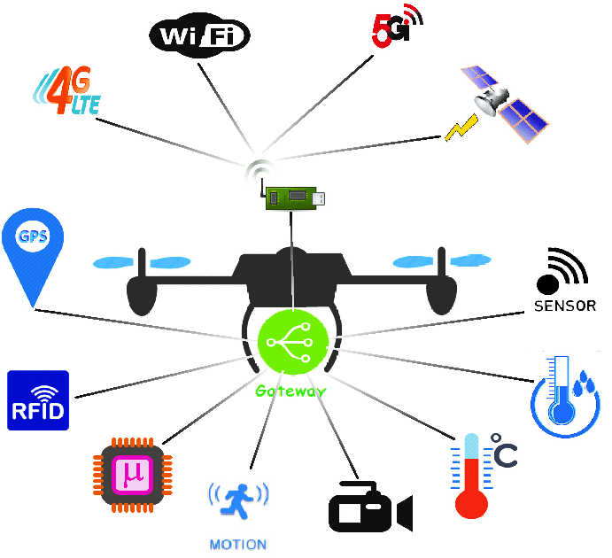
Is drone considered IoT?
“Drones are an emerging form of new IoT devices, flying in the sky with full network connectivity capabilities.
In an IoT setting, a drone could act as a mobile sensor to gather data and relay it back to a cloud app or some other analytics service. Drones can also be used as remote inspection devices to help maintain IoT endpoints and other components.

Slide 8
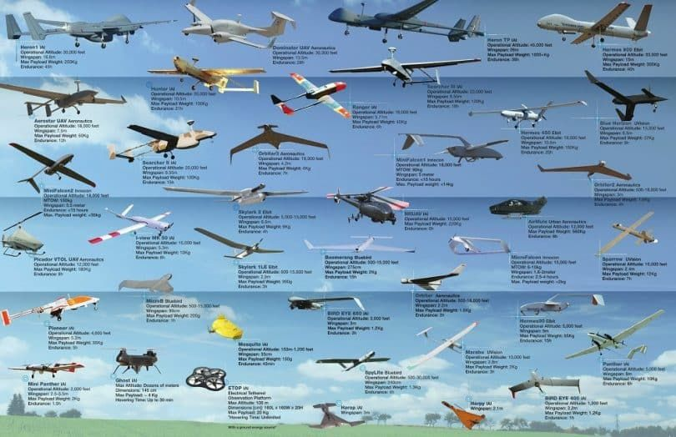
What types of drones are available?
There are two main types of drone platforms:
rotor, including single-rotor and multi-rotor, such as tri-copters, quadcopters, hex-copters and octocopters
fixed-wing, which include the hybrid vertical take-off and landing (VTOL) drones that don't require runways.
Nonmilitary drones are generally either personal and hobbyist ones or commercial aircraft.

Slide 9
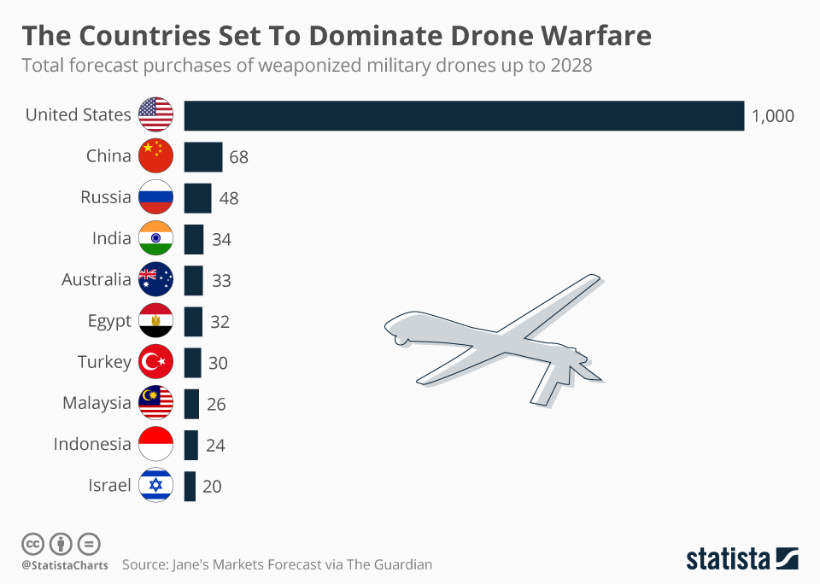
Military drones stats
Top Sellers
United States
Israel
China are the biggest producers and sellers of drones.
America’s leading combat drone is the MQ-9 Reaper
Top Buyers
India
United Kingdom
Indian Navy has leased two MQ-9B SeaGuardian drones from the US. The proposed induction of the MQ-9Bs would give India the distinction of being the only non-NATO country to receive these combat drones from the US

Slide 10
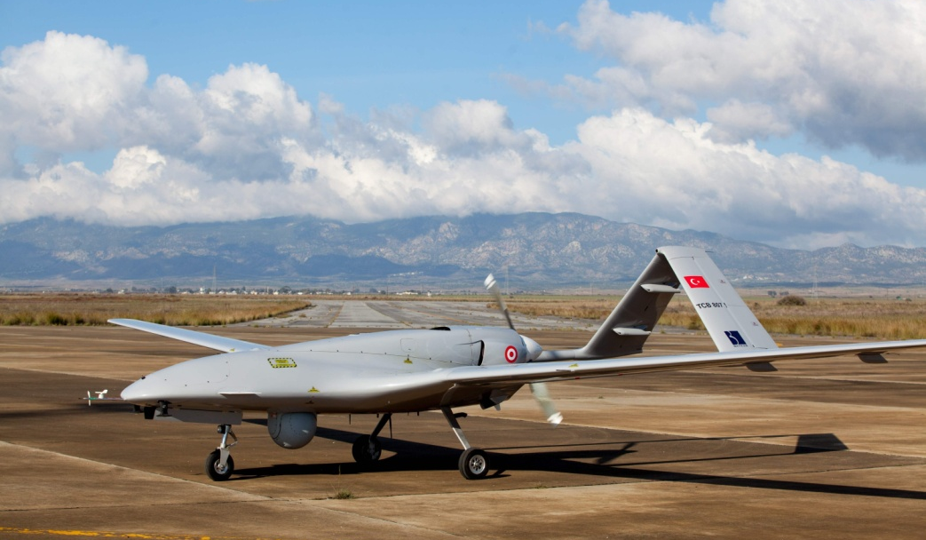
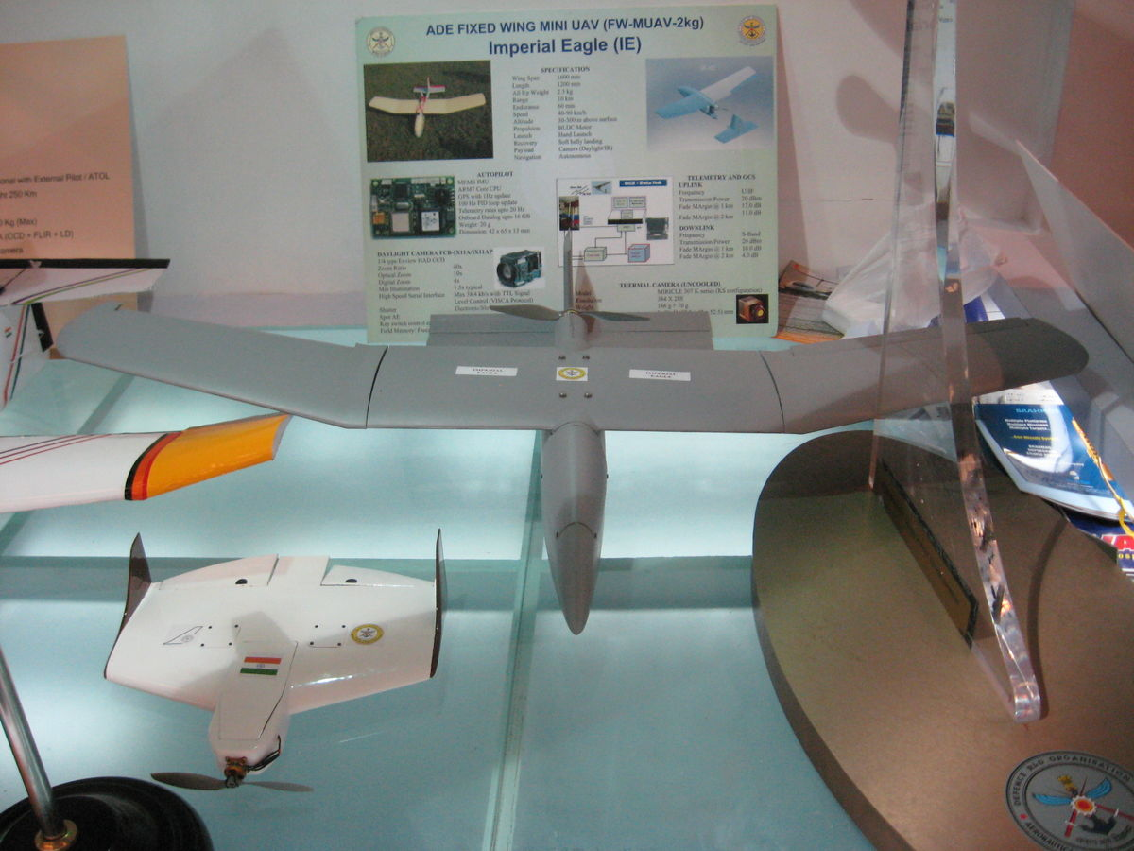
Military drones in action
Bayraktar TB2 unmanned combat aerial vehicle helped Ukrainians in their fight is the Bayraktar TB2 unmanned combat aerial vehicle - a Turkish-made drone that can carry small anti-armor weapons.
The Imperial Eagle is an Indian light-weight mini-UAV developed by the Aeronautical Development Establishment, National Aerospace Laboratories and supported by private vendors. Its primary users are the National Security Guard(NSG) and the military services

Slide 11
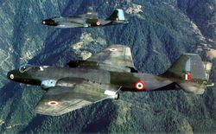
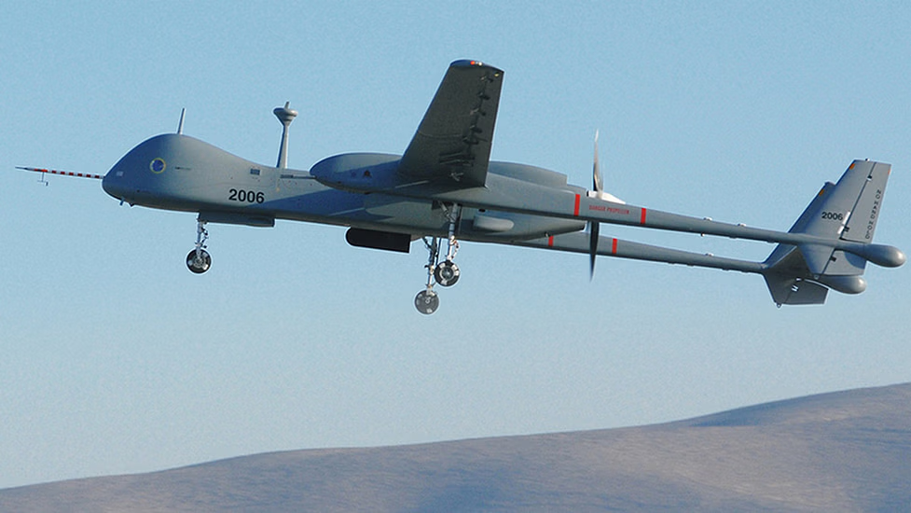
Looking Back: Drones In India
The Indian Army was the first to acquire unmanned aerial vehicles or UAVs in the late 1990s from Israel, and the Indian Air Force and Navy followed suit.
India first used military drones during the 1999 Kargil war with Pakistan. At first, the Indian Air Force deployed manned English aircraft for photo reconnaissance along the Line of Control, but this system proved highly inefficient and strategically weak over the mountainous Kargil terrain.
After India lost a Canberra PR57 to Pakistani infrared homing missiles, Israel discreetly supplied the Indian Air Force with the IAI Heron and Searcher drones, which were useful for acquiring target information along the Line of Control.
Since Kargil, India has procured numerous Israeli military unmanned aircraft. In 2009, the Indian Air Force purchased 10 Harops in a $100 million contract with Israel Aerospace Industries.
In 2013, the Indian Air Force made a $280 million deal with Israel Aerospace Industries for a new series of Heron medium-altitude, long-endurance drones.

Slide 12
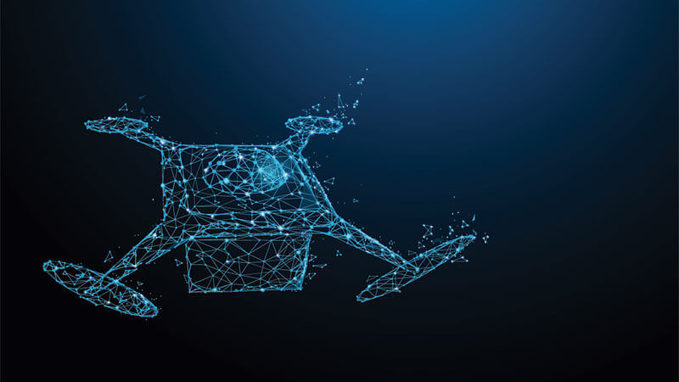
Cybersecurity and Drones
The Cybersecurity Threat of Drones
GPS spoofing. A way to take control of a drone. Attackers feed drones with false GPS coordinates and take full control of the platform.
Downlink intercept. Allows a criminal accessing all transmitted data between the drone and the controller. Since the majority of commercial drones systems interact with their base using unencrypted communication channels, they can become vulnerable to exploitation by a cyber criminal who can intercept and have access to sensitive data drone exchanges with the base such as pictures, videos, and flight paths.
Data exploitation. Critical infrastructure is protected in the terms of digital and physical security. points, unsecured networks, and devices,

Slide 13
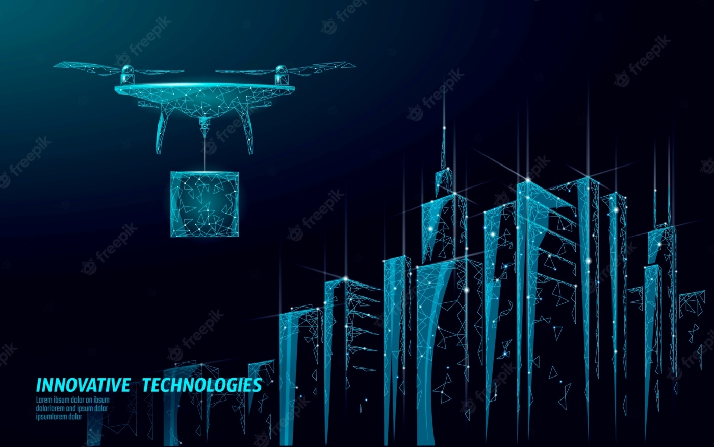
How to Mitigate the Threat
To mitigate the cybersecurity risks posed by the drones, we need to consider the following:
How to secure the platform and the data exchanged
How to counter drone platforms
Securing Drones
Kaspersky proposes some useful tips:
Update the drone’s firmware and apply a manufacturer’s patches.
Use strong passwords for the base station application.
Use updated anti-virus software for your drone controller device.
Subscribe to a VPN service to encrypt your connection.
Limit the number of devices that can connect to the base station.
Use the “Return to Home” (RTH) mode to ensure drone recovery from a hijack situation.

Slide 14
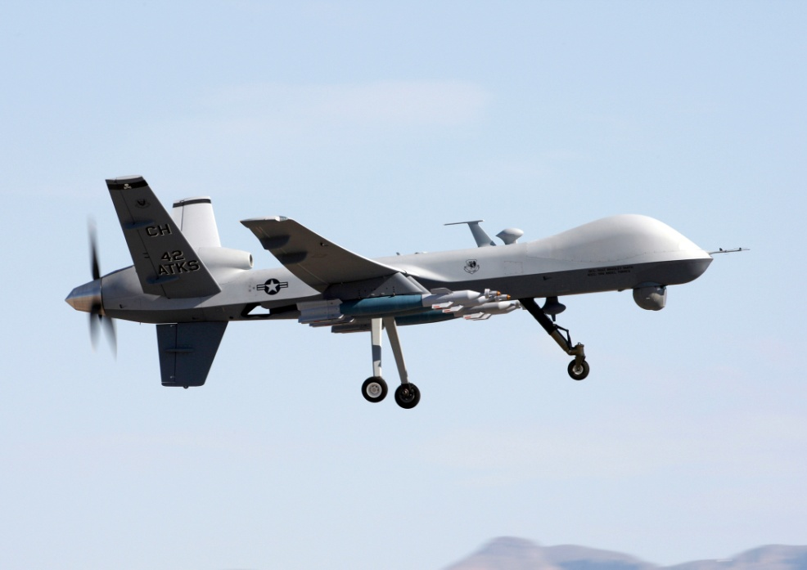
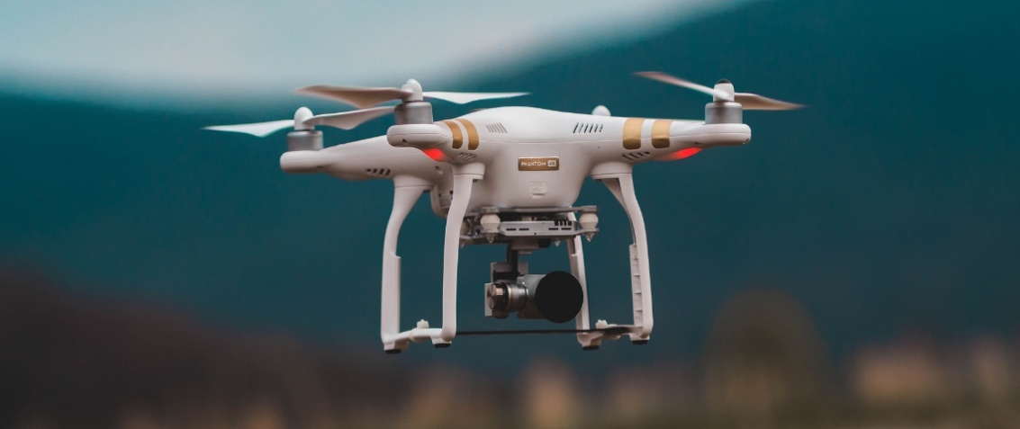
Conclusion
Drones are becoming commonplace in both the commercial and non-profits sectors. In the near future their use will be even more widespread.
Agriculture: The Environmental Protection Agency already utilizes drones technology to manage livestock and survey crops. In the future farmers and ranchers could use unmanned aircraft to strategically monitor and spray their crops.
Conservation: Unmanned aircraft are being used to monitor endangered species and map the changes in various ecosystems around the globe. As drone technology advances, the use and impact of unmanned aircraft in conservation efforts will expand.
Delivery: Anything the postman can carry can also be delivered by drone. Food, prescriptions, etc
Disaster mitigation and relief: Drones can go places that humans can’t access, so they are an ideal solution for dangerous search and rescue efforts
Logistics: Heavy-duty drones can replace trucks for inventory management and moving goods between warehouses.
Filmmaking and photography, Law enforcement , etc

Slide 15
PRESENTED BY :
122010324035 - G.Naga sai saran 122010325007 - B.Sai Srujan 122010325012 – S.Jaswanth

Slide 16


